Slide 1

Iteration One UofL Basketball Team Project
Team ACE
Daniel Aguilar, Isaiah Collins, Alex Graf, Emmanuel Haynes, Shane Peterson, Mambuna Touray

Slide 2

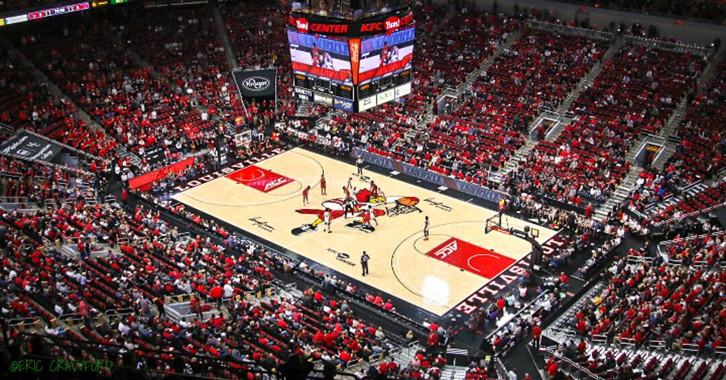
Overview
Iteration 1 Deliverables:
System Request
Narrative: Problem Statement, Business Care, Feasibility Considerations
Process Models: As-Is and To-Be
Vision Document
Agile Stories

Slide 3

System Request
Business Needs:
Exclusive database/website for basketball team
Increase efficiency of tracking all data regarding the team and players
Increase Security of important data
Data Visualization: Make hard data easy to understand for coaches/faculty
Business Requirement:
Online Website: Act as a home for all staff. Will help lead members of staff to their desired points of interest.
Database: Managers and other Staff can input data for the team. Will store all the team data.
Firewalls/Multi Authentication: Allow for more security of Player info and Team Data.
Payment system

Slide 4
System Request
Business Value
Coaches will have access to useful player information and analytics which they can use to adjust training and other factors to improve performance
Admins and Managers will be able to upload and retrieve data from a central location
The ability to have sensitive information encrypted and secure
Special Issues/Constraints
Need to constantly update data such as player statistics
Cybersecurity of website
Deadline: April 28,2023
Project Sponsor
-Professor Zara Hatami

Slide 5
Narrative
Problem: As it currently stands it is a little challenging for the UofL men's basketball team to interpret and analyze the vast amount of data they receive on a day-to-day basis.
The UofL Men's Basketball team would like a central location that can hold all the information and data that they collect.
Technical Feasibility: With this being private data that needs to be utilized by many different professionals within the athletic department, we would like to set it up in a way that allows for easy accessibility of the data. The most effective approach to accomplish this would be to switch them over from their existing hard-drive system to a cloud-based system
Business Case: This data will be able to be accessed at any time and utilized by any personal with access. By being able to view all this mass amounts of data easily and in real time it can lead to crucial and efficient recommendations
Economic Feasibility
WordPress : $25/month if billed annually
One-Drive Cloud Storage: Microsoft 365 Business Standard $12.50 (annual subscription)
Business-class email, Office apps, and services like OneDrive. With 1 TB per user.

Slide 6
Narrative
Organizational Feasibility:
The University of Louisville basketball team lacks the technology and technical expertise needed to have a useful analytics system. The system in use now is hard to use and does not meet all the requirements of the team. Using the services, we have suggested we anticipate achieving the following:
Create an easy-to-use database for creators of data and its users
Have multiple ways to analyze data in a meaningful way
Make information easy to access, useable, and most importantly, secure.
Make a system that can be used by students and developers in the future, even when the original creators are no longer able to help.

Slide 7
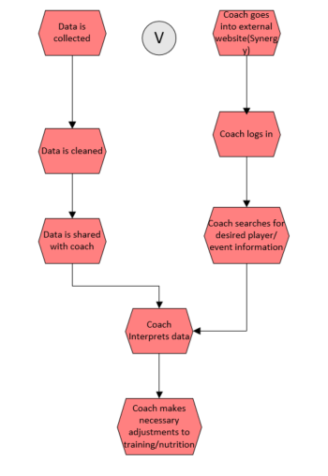
Process Model: As-Is

Slide 8
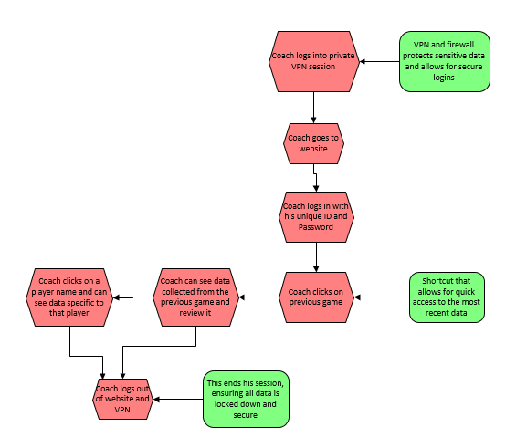
Process Model: To-Be

Slide 9
Vision Document
Stakeholder: Louisville Men's Basketball Team
Users:
- Players
Coaches
Admins
Visitors
Needs:
Centralized database
Able to add and update data on the database
Ease of access to statistics and analytics
Increased security
Different access levels

Slide 10
Vision Document
Our Product:
Website
WordPress
MySQL
Assumptions & Requirements :
- Upkeep and general maintenance of website
- Requirement to constantly update data
- Knowledge of WordPress and MySQL

Slide 11
Agile Stories
ID: 2208
Title: Player
As: The main subject of the research and the person looking for ways to improve.
Workflow(I want to): Reflect on my performance and have data to correlate to my best route of success.
Benefited(So that): I can find subtle improvements I can make to benefit the team.
When I use this database, I can analyze the best lifestyle decisions for me to maximize my performance on the court.
ID: 2209
Title: Strength & Conditioning Coach
As: The person in charge of building athletes' bodies to peak for performance.
Workflow(I want to): Use the data collected to guide each player in the right direction.
Benefited(So That): Specialized workout and nutrition plans can be optimized for every athlete.
When I use this database, I will have access to how every athlete is progressing and be able to properly adjust on a day to day basic to maximize player output.

Slide 12
Agile Stories
ID: 2210
Title: Administrator
As: The main person scheduling of games and facilities.
Workflow (I want to): Analyze player stats to better understand how prepared we are to face each team in our schedule.
Benefitted (so that) : Practices can be tailored towards player weaknesses and against opposing teams' strengths.
When I use this database, I can compare our player's current stats against previous stats to track improvement.
ID: 2210
Title: Head Coach
As: the main person coaching, developing character, and providing direction to student athletes.
Workflow (I want to): Use the data collected to guide each player in the right direction.
Benefitted (so that) : Specialized practices and coaching plans can be created to help players reach their full potential.
When I use this database, I can see what areas my team is exceling in and falling behind in so that I can make the proper practice adjustments.

